Slide 1
Building Community Through House Concerts and WUVT
Jim Dubinsky
Director, Center for the Study of Rhetoric in Society (CSRS)
Department of English
Virginia Tech

Slide 2
What are House Concerts?
A musical event presented in someone’s home or, occasionally, in another small space such as a backyard or community meeting room.
Johnsmith, a folk musician said, it is “Music as it should be…in the home, from the heart.”

Slide 3
Why House Concerts?
“They bring people together for one night, often complete strangers, which can sometimes facilitate more lasting friendships. In addition, you get to hear live music and support the independent arts. Helping one person achieve success inspires others to take chances. Additionally, you can directly support the artist, instead of a venue taking a cut. I wish more musicians would do house concert tours.”
—Jenny Williams, blogger for Wired

Slide 4
What else is possible?
Partnerships with local nonprofits such as
The New River Land Trust
The Artful Lawyer
Partnerships with larger venues such as the Center for the Arts
Outreach opportunities with schools (Blacksburg New School)
See next video to witness several of these partnerships.

Slide 5


Video from Khumariyaan & Boston Boys at MHC
Watch a video from their visit.

Slide 6
Which Artists Play House Concerts?
At one time or another, any artist might play a house concert.
According to David Wax, the biggest payoff from independently booked shows is the personal investment organizers make. "It's one thing to invite people out to a concert — it's another to say, 'This is a band I love so much that I'm having them play at my house,'" says Wax. "It doesn't take that many people getting together to make it extremely valuable to the artist.”

Slide 7

Monkey House Concerts
Formed in 2010 by Robyn and Jim Dubinsky
Goal: Build Community, One House Concert at a Time
Provide opportunities for our community to hear artists we have come to know and appreciate.
Provide opportunities for artists to visit our community and come to love our region and its people.
Focus on the music – an intimate listening space.

Slide 8
What kinds of musicians play at MHC?
We have hosted a wide range of artists, to include--
Miche Fambro (extraordinary guitar player and jazz crooner/singer-songwriter)
Kipyn Martin, award-winning singer-songwriter (folk tradition)
Kutumba (folk instrumental ensemble committed to the research, preservation and celebration of the diversity that exists in indigenous Nepali music)
Khumariyaan & the Boston Boys* (Pakistani band & Indie-Folk/Soul/R&B band)
David Wax/Suz Slezak* (Indie band blending music of several cultures)
* in partnership with other nonprofits such as The Artful Lawyer and the Center for the Arts

Slide 9
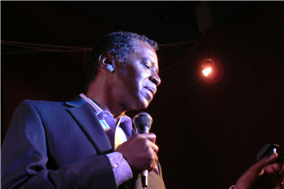
Miché Fambro
A man of many skills, Miché captivated his listeners with his mastery of the guitar. But his mastery of the guitar was not his only forte; Miché demonstrated that he an amazing singer with skills that equally match his guitar prowess. The bottom line--Miché knows how to entertain; and he did it well. One of the magical parts about Miché’s performances is that he fused elements of flamenco, jazz, classical, pop and soul into a style all his own.﻿
See http://michefambro.com
Watch video from our house concert.

Slide 10
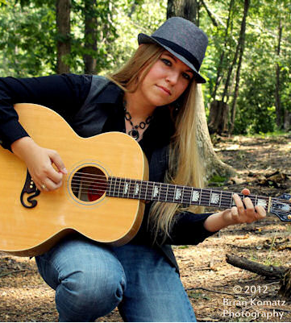
Kipyn Martin
﻿
When you hear a new artist for the first time, there is always some facet or characteristic that you’ll initially pick up on.
With Kipyn Martin it’s undoubtedly her voice, an instrument of unrefined purity, which is wonderfully suited to her blues based folk and Americana material. She’s honed her style by extensively touring with her mentor, Pops Walker, throughout Western and Northern Virginia, and playing many gigs in her current hometown of Washington DC. In between she’s received a Master of Music degree in composition from Shenandoah Conservatory in Winchester, VA. –
See more at: http://www.kipynmartin.com/
Watch a video from our house concert

Slide 11
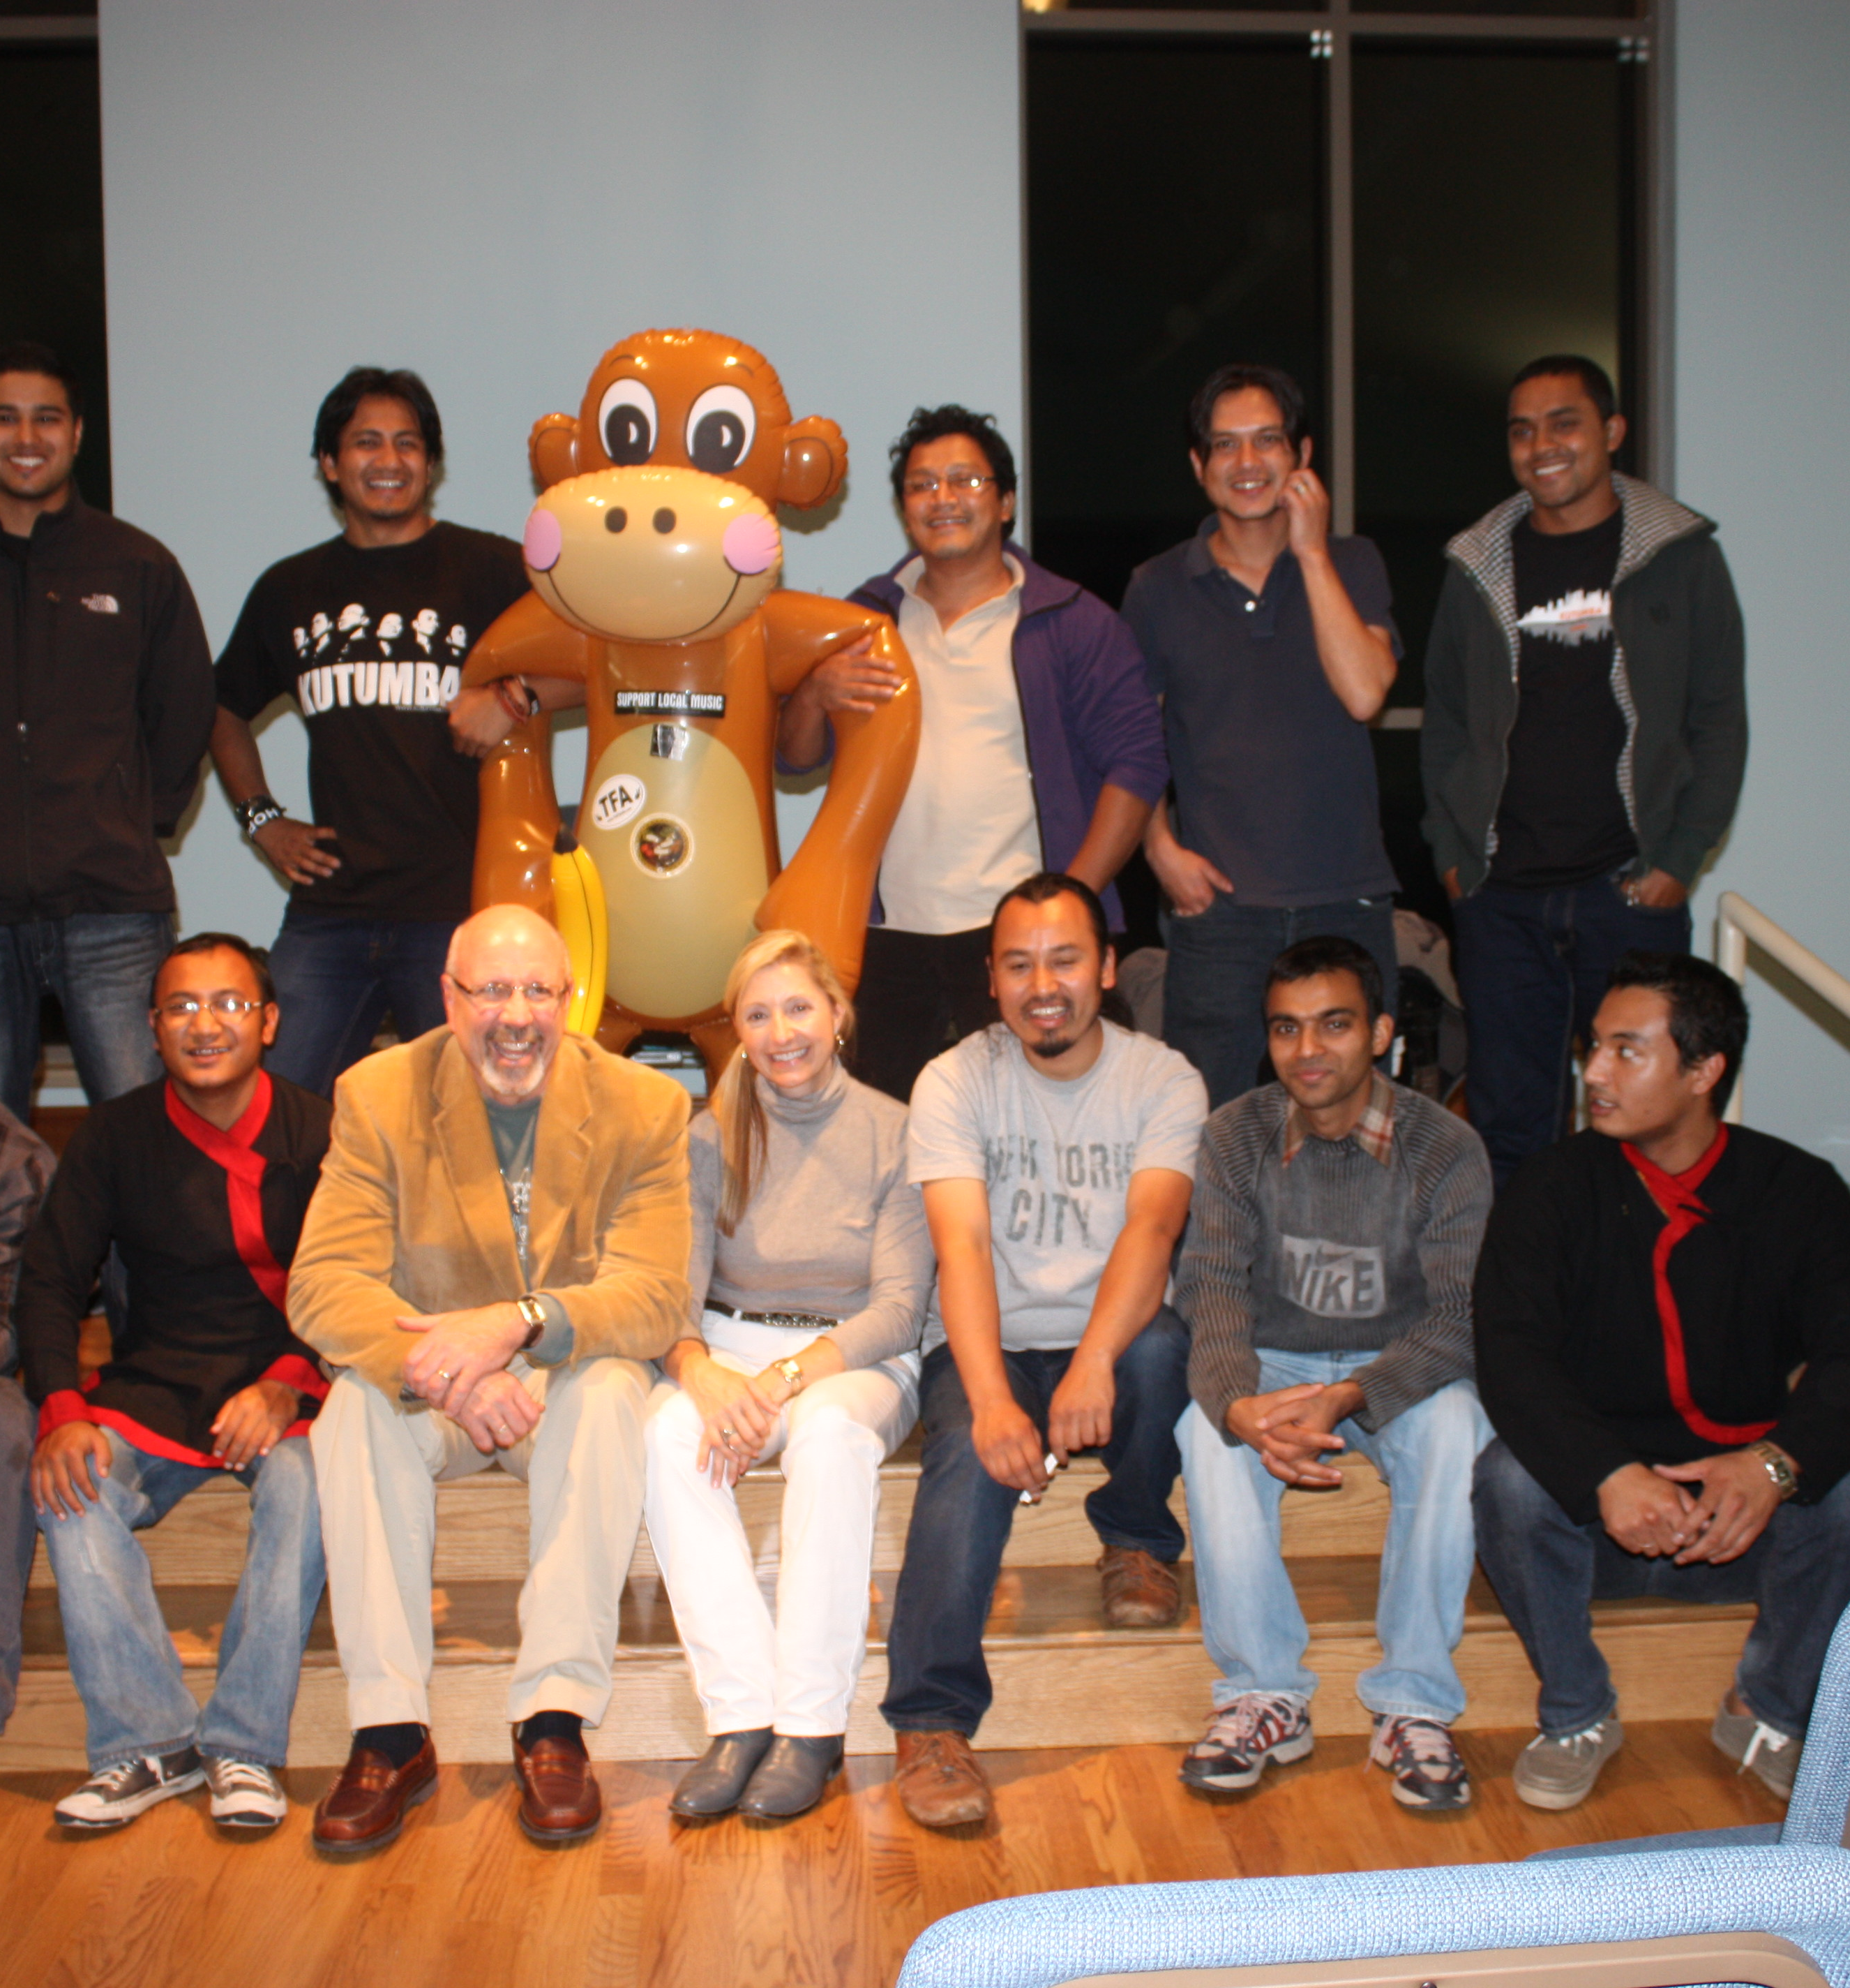
Kutumba
Kutumba is a folk instrumental ensemble committed to the research, preservation and celebration of the diversity that exists in indigenous Nepali music. The word ‘Kutumba’ holds a special meaning in the Nepali language. It stands for a unique bond amongst community members. As their name, Kutumba is all about bringing together traditional folk tunes and instruments with new and improvised sounds and ideas. Kutumba is a folk instrumental ensemble, group of six professionals from Kathmandu.
See http://kutumba.com.np/
View short video from the concert.

Slide 12
How Do House Concerts Work?
The hosts of the house concert book a band – bands will contact the venue; the hosts will go directly to a band; or sometimes a third party provider such as Concerts in Your Home will facilitate the contact.
Hosts work out an agreement with the band – length of gig, arrival time, set-up time, food/lodging, etc.
Hosts will let people know about the event (using listservs, contact lists, websites).
Guests will reserve seats.
On night of the event, guests will donate money to the band (hosts do not take any funds).
In most house concerts, some community building via food and drink occurs, often with guests bringing some food item to share (e.g., potluck).
Most artists will spend the night with the host and leave the next morning.

Slide 13
Coming to MHC Soon: Artist Videos
Honey Dewdrops: https://www.youtube.com/watch?v=ehdIfLVb5hA
Caleb Stein: https://www.youtube.com/watch?v=7IJXvPHRZws&index=44&list=PLJEe7ay4XZ6d2_A-Wy6QQMkiCil_oA1wm
Betty Soo: https://www.youtube.com/watch?v=QOL-SajUcyA&index=2&list=PLD5061D4120E357C3
Robyn Ludwick: https://www.youtube.com/watch?v=88pYNmRmlI8&index=10&list=PLmSX8EmlP-SUn-xOzpYNDfzsYrDN2C49m
Bob Sima: https://www.youtube.com/watch?v=X2aNKD2OQh4
https://www.youtube.com/watch?v=6y4mQh0ZFnY

Slide 14
Learn More
Visit our website: http://monkeyhouseconcerts.net

